Slide 1
Structural Patterns -II
Emre Kaplan, Ph.D.

Slide 2
Structural Patterns
Structural patterns are concerned with how classes and objects are composed to form larger structures.
Structural class patterns use inheritance to compose interfaces or implementations.
Structural object patterns describe ways to compose objects to realize new functionality.
The added flexibility of object composition comes from the ability to change the composition at run-time, which is impossible with static class composition.
Source: Erich Gamma, Richard Helm, Ralph Johnson, and John Vlissides. 1995. Design Patterns: Elements of Reusable Object-Oriented Software. Addison-Wesley Longman Publishing Co., Inc., Boston, MA, USA.

Slide 3
Structural Patterns
Structural Patterns
Adapter
Façade
Decorator
Proxy
Composite
Bridge
Flyweight

Slide 4
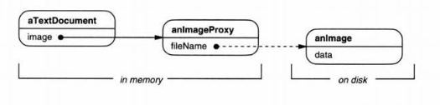
Proxy
Intent
Provide a surrogate or placeholder for another object to control access to it.
Motivation
defer the full cost of creating and initializing an object until we actually need it.

Slide 5
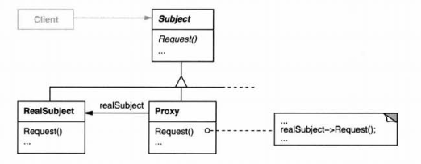

Structure

Slide 6
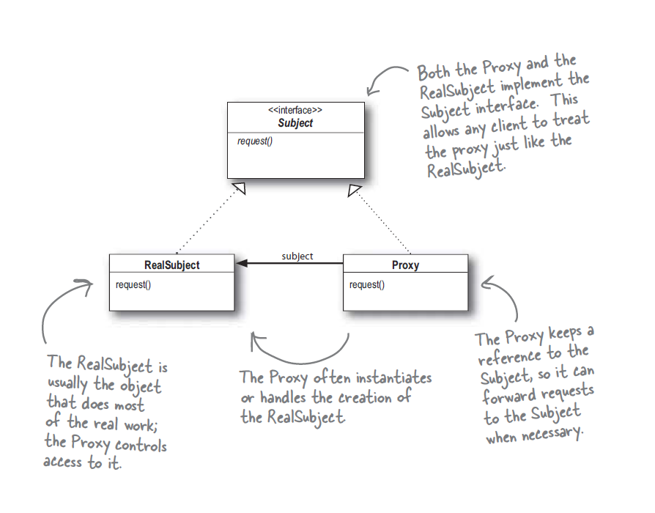
Proxy

Slide 7
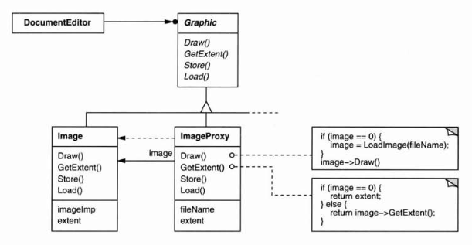
Proxy

Slide 8
Participants
Proxy (ImageProxy)
Maintains a reference that lets the proxy access the real subject.
provides an interface identical to Subject's so that a proxy can by substituted for the real subject.
controls access to the real subject and may be responsible for creating and deleting it.
Subject (Graphic)
Defines the common interface for RealSubject and Proxy so Proxy can be used anywhere where a RealSubject is expected
RealSubject (Image)
Defines the real object that the proxy represents

Slide 9
Applicability
A remote proxy provides a local representative for an object in a different address space.
A virtual proxy creates expensive objects on demand.
A protection proxy controls access to the original object.
Protection proxies are useful when objects should have different access rights.
A smart reference is a replacement for a bare pointer that performs additional actions when an object is accessed.
E.g.: smart pointers, mutual exclusion

Slide 10
Consequences
The Proxy pattern introduces a level of indirection when accessing an object. The additional indirection has many uses, depending on the kind of proxy:
A remote proxy can hide the fact that an object resides in a different address space.
A virtual proxy can perform optimizations such as creating an object on demand.
Both protection proxies and smart references allow additional housekeeping tasks when an object is accessed.
Optimization can be obtained for heavyweight objects, by doing copy-on-demand via proxies.

Slide 11
Composite
Intent
Compose objects into tree structures to represent part-whole hierarchies. Composite lets clients treat individual objects and compositions of objects uniformly.
The key to the Composite pattern is an abstract class that represents both primitives and their containers.

Slide 12
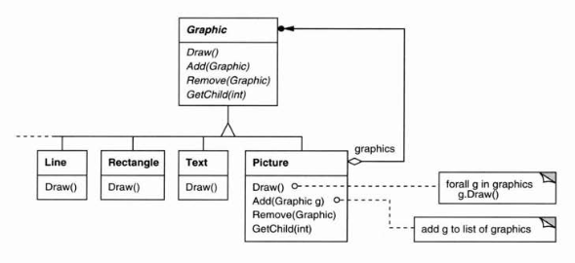
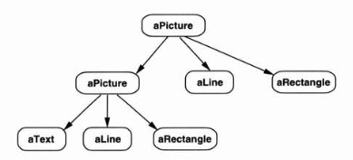
Composite

Slide 13
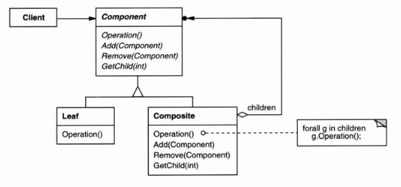
Structure

Slide 14
Participants
Component (Graphic)
declares the interface for objects in the composition.
implements default behavior for the interface common to all classes, as appropriate.
declares an interface for accessing and managing its child components.
Leaf (Rectangle, Line, Text, etc.)
represents leaf objects in the composition. A leaf has no children.
defines behavior for primitive objects in the composition.
Composite (Picture)
defines behavior for components having children.
stores child components.
implements child-related operations in the Component interface.
Client
manipulates objects in the composition through the Component interface.

Slide 15
Applicability
Use the Composite pattern when:
You want to represent part-whole hierarchies of objects
You want clients to be able to ignore the difference between compositions of objects and individual objects.
Client will threat all objects in the composite structure uniformly.

Slide 16
Consequences
makes the client simple.
makes it easier to add new kinds of components.
can make your design overly general.
maximal interface for the Composite.
child management operations (e.g. add, remove) can be pushed down to Composite, but then Leaf and Composite will have different interfaces

Slide 17
Implementation
Explicit parent references
Sharing components
Problematic if keeping reference to parent: multiple parents
Putting the child pointer in the base class incurs a space penalty for every leaf, even though a leaf never has children.
It's usually best to make a Composite responsible for deleting its children when it's destroyed.

Slide 18
Bridge
Intent
Decouple an abstraction from its implementation so that the two can vary independently.
Motivation
When an abstraction can have one of several possible implementations, the usual way to accommodate them is to use inheritance.
But inheritance binds an implementation to the abstraction permanently, which makes it difficult to modify, extend, and reuse abstractions and implementations independently.

Slide 19
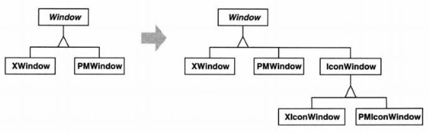
Bridge
E.g.: It's inconvenient to extend the Window abstraction to cover different kinds of windows or new platforms.
Clients should be able to create a window without committing to a concrete implementation.

Slide 20
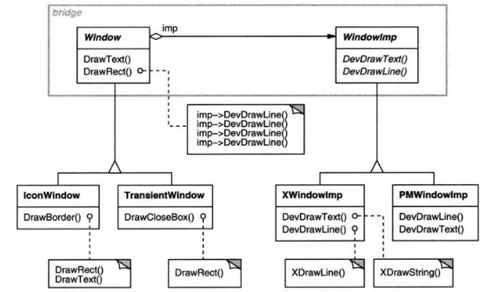
Bridge
Put the Window abstraction and its implementation in separate class hierarchies.

Slide 21
Bridge
Abstraction (Window)
defines the abstraction's interface.
maintains a reference to an object of type Implementor.
RefinedAbstraction (IconWindow)
Extends the interface defined by Abstraction.
Implementor (WindowImp)
defines the interface for implementation classes. This interface doesn't have to correspond exactly to Abstraction's interface; in fact the two interfaces can be quite different. Typically the Implementor interface provides only primitive operations, and Abstraction defines higher-level operations based on these primitives.
ConcreteImplementor (XWindowImp, PMWindowImp)
implements the Implementor interface and defines its concrete implementation.

Slide 22
Applicability
Use the Bridge pattern when
you want to avoid a permanent binding between an abstraction and its implementation.
both the abstractions and their implementations should be extensible by sub classing.
changes in the implementation of an abstraction should have no impact on clients

Slide 23
Applicability
Use the Bridge pattern when
you want to hide the implementation of an abstraction completely from clients.
you have an increasing number of classes as shown earlier in the first motivation diagram.
you want to share an implementation among multiple objects, and this fact should be hidden from the client.

Slide 24
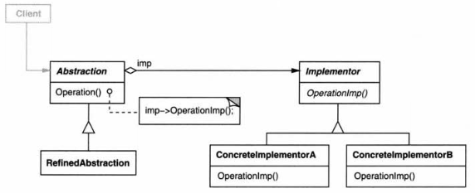
Structure

Slide 25
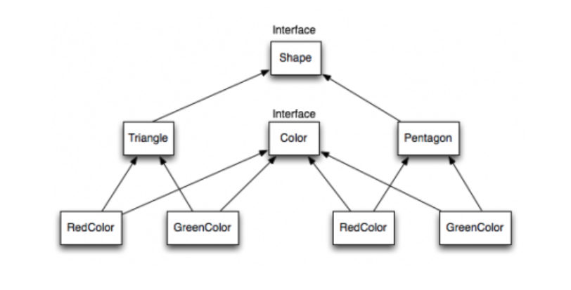
Bridge
Easy to realize?
Source :https://www.journaldev.com/1491/bridge-design-pattern-java

Slide 26
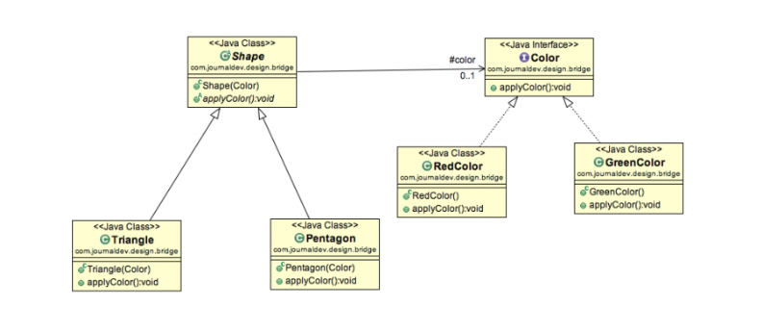
Bridge

Slide 27
Consequences
Decoupling interface and implementation.
It's even possible for an object to change its implementation at run-time.
Also eliminates compile-time dependencies on the implementation.
essential when you must ensure binary compatibility between different versions of a class library.
Can extend the Abstraction and Implementor hierarchies independently.
Hiding implementation details from clients.

Slide 28
Implementation
Only one Implementor.
creating an Abstract Implementor class isn't necessary.
Creating the right Implementor object.
How, when, and where do you decide which Implementor class to instantiate?
Abstraction’s constructor
Abstract Factory

Slide 29
Implementation
Using multiple inheritance.
Inherit publicly from Abstraction and privately from a ConcreteImplementor.
relies on static inheritance
binds an implementation permanently to its interface.
can't implement a true Bridge with multiple inheritance

Slide 30
Flyweight
Intent
Use sharing to support large numbers of fine-grained objects efficiently.
Motivation
Some applications could benefit from using objects throughout their design, but a naive implementation would be prohibitively expensive.
It is used to minimize memory usage or computational expenses by sharing as much as possible with similar objects.

Slide 31
Flyweight
A flyweight is a shared object that can be used in multiple contexts simultaneously.
The flyweight acts as an independent object in each context—it's indistinguishable from an instance of the object that's not shared.
Flyweights cannot make assumptions about the context in which they operate.
Distinction between intrinsic and extrinsic state.
Intrinsic state is stored in the flyweight
it consists of information that's independent of the flyweight's context, thereby making it sharable.
Extrinsic state depends on and varies with the flyweight's context and therefore can't be shared.
Client objects are responsible for passing extrinsic state to the flyweight when it needs it.

Slide 32
Flyweight
Flyweight pattern lets multiple clients share access to a limited number of objects: the flyweights.
For this to work, you have to consider that when a client changes the state of an object, the state changes for every client that has access to the object.
When multiple clients will share access to an object, the easiest and most common way to keep clients from affecting one another is to restrict clients from introducing any state changes in the shared object.
You can achieve this by making an object immutable, so that once created, the object cannot change.

Slide 33
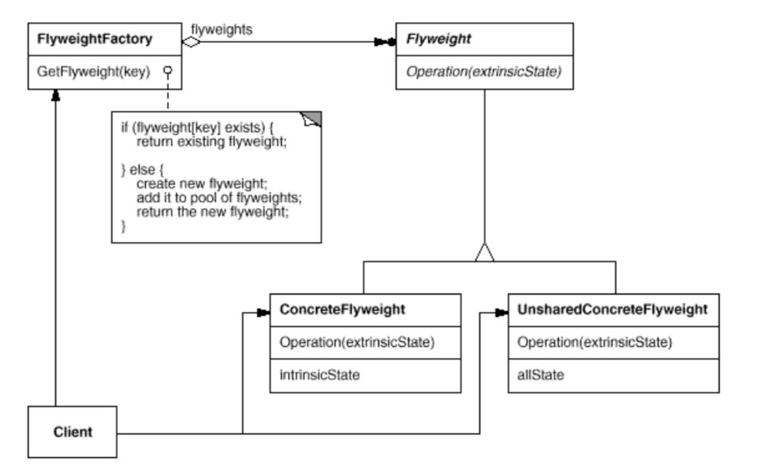
Structure

Slide 34
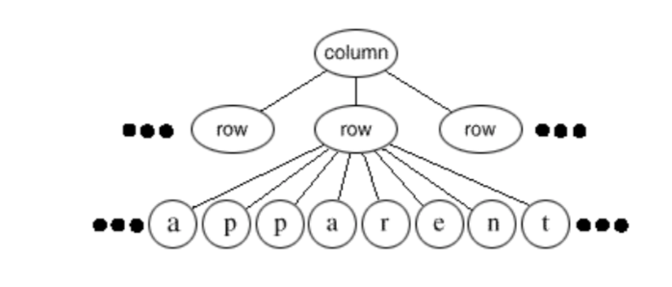
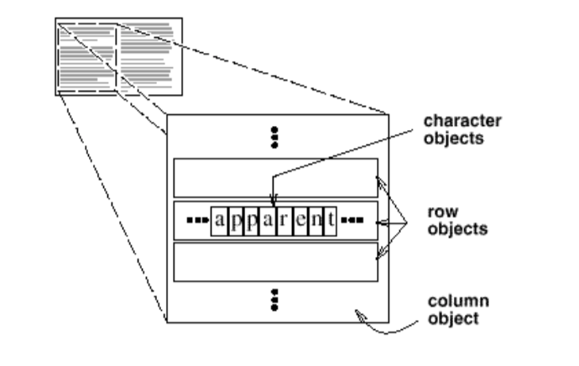
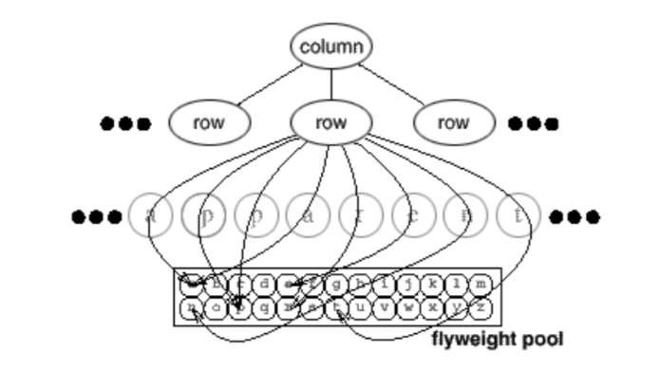
Editor

Slide 35
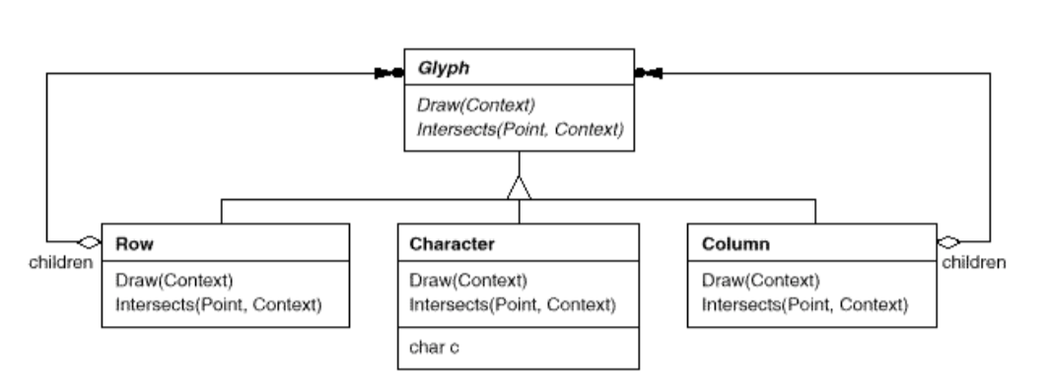
Editor

Slide 36
Participants
Flyweight (Glyph)
declares an interface through which flyweights can receive and act on extrinsic state.
ConcreteFlyweight (Character)
implements the Flyweight interface and adds storage for intrinsic state, if any. A ConcreteFlyweight object must be sharable. Any state it stores must be intrinsic; that is, it must be independent of the ConcreteFlyweight object's context.
UnsharedConcreteFlyweight (Row, Column)
not all Flyweight subclasses need to be shared. The Flyweight interface enables sharing; it doesn't enforce it. It's common for UnsharedConcreteFlyweight objects to have ConcreteFlyweight objects as children at some level in the flyweight object structure (as the Row and Column classes have).
FlyweightFactory
creates and manages flyweight objects.
ensures that flyweights are shared properly. When a client requests a flyweight, the FlyweightFactory object supplies an existing instance or creates one, if none exists.
Client
maintains a reference to flyweight(s).
computes or stores the extrinsic state of flyweight(s).

Slide 37
Collaborations
Flyweight state must be characterized as either intrinsic or extrinsic.
Intrinsic state is stored in the ConcreteFlyweight object; extrinsic state is stored or computed by Client objects.
Clients pass this state to the flyweight when they invoke its operations.
Clients should not instantiate ConcreteFlyweights directly.
Clients must obtain ConcreteFlyweight objects exclusively from the FlyweightFactory object to ensure they are shared properly.

Slide 38
Consequences
Flyweights may introduce run-time costs associated with transferring, finding, and/or computing extrinsic state, especially if it was formerly stored as intrinsic state.
However, such costs are offset by space savings, which increase as more flyweights are shared.
Storage savings are a function of several factors:
the reduction in the total number of instances that comes from sharing
the amount of intrinsic state per object
whether extrinsic state is computed or stored.
The more flyweights are shared, the greater the storage savings.

Slide 39
Applicability
The Flyweight pattern's effectiveness depends heavily on how and where it's used. Apply the Flyweight pattern when all of the following are true:
an application uses a large number of objects
storage costs are high because of the number of objects
most object state can be made extrinsic
many groups of objects may be replaced by relatively few shared objects once extrinsic state is removed
the application doesn't depend on object identity. Since flyweight objects may be shared, identity tests will return true for conceptually distinct objects
https://java-design-patterns.com/patterns/flyweight/

